Slide 1
Introduction in Java
Dr. Naveen Kumar
Associate Professor
Amity Institute of Information Technology
Amity University Patna

Slide 2
Procedural Oriented vs Object Oriented
Procedural Programming derived from structured programming, based upon the concept of calling procedure. Procedures, also known as routines, subroutines or functions, simply consist of a series of computational steps to be carried out. During a program’s execution, any given procedure might be called at any point, including by other procedures or itself.
FORTRAN, ALGOL, COBOL, BASIC, Pascal and C.
Object-oriented programming based upon the concept of objects. Objects contain data in the form of attributes and code in the form of methods. In object-oriented programming, computer programs are designed using the concept of objects that interact with the real world. Object-oriented programming languages are various but the most popular ones are class-based, meaning that objects are instances of classes, which also determine their types.
Java, C++, C#, Python, PHP, JavaScript, Ruby, Perl, Objective-C, Dart, Swift, Scala.

Slide 3
Procedural Oriented Programming | Object-Oriented Programming
In procedural programming, the program is divided into small parts called functions. | In object-oriented programming, the program is divided into small parts called objects.
Procedural programming follows a top-down approach. | Object-oriented programming follows a bottom-up approach.
There is no access specifier in procedural programming. | Object-oriented programming has access specifiers like private, public, protected, etc.
Adding new data and functions is not easy. | Adding new data and function is easy.
Procedural programming does not have any proper way of hiding data so it is less secure. | Object-oriented programming provides data hiding so it is more secure.
In procedural programming, overloading is not possible. | Overloading is possible in object-oriented programming.
In procedural programming, there is no concept of data hiding and inheritance. | In object-oriented programming, the concept of data hiding and inheritance is used.
In procedural programming, the function is more important than the data. | In object-oriented programming, data is more important than function.
Procedural programming is based on the unreal world. | Object-oriented programming is based on the real world.
Procedural programming is used for designing medium-sized programs. | Object-oriented programming is used for designing large and complex programs.
Procedural programming uses the concept of procedure abstraction. | Object-oriented programming uses the concept of data abstraction.
Code reusability absent in procedural programming, | Code reusability present in object-oriented programming.
Examples: C, FORTRAN, Pascal, Basic, etc. | Examples: C++, Java, Python, C#, etc.

Slide 4
Procedural Oriented Programming | Object-Oriented Programming
Procedural programming is used for designing medium-sized programs. | Object-oriented programming is used for designing large and complex programs.
Procedural programming uses the concept of procedure abstraction. | Object-oriented programming uses the concept of data abstraction.
Code reusability absent in procedural programming, | Code reusability present in object-oriented programming.
Examples: C, FORTRAN, Pascal, Basic, etc. | Examples: C++, Java, Python, C#, etc.

Slide 5
Object Oriented Programming
Object-Oriented Programming or OOPs which deals everythings in the form of objects in programming.
Implements real-world entities like inheritance, hiding, polymorphism, etc in programming. The main aim of OOP is to bind together the data and the functions that operate on them so that no other part of the code can access this data except that function.

Slide 6
OOPs Concepts:
Class
Objects
Data Abstraction
Encapsulation
Inheritance
Polymorphism
Dynamic Binding
Message Passing

Slide 7
1. Class:
A class is a user-defined data type. It consists of data members and member methods, which can be accessed and used by creating an instance of that class. It represents the set of properties or methods that are common to all objects of one type. A class is like a blueprint for an object.
For Example: Consider the Class of Cars. There may be many cars with different names and brands but all of them will share some common properties like all of them will have 4 wheels, Speed Limit, Mileage range, etc. So here, Car is the class, and wheels, speed limits, mileage are their properties.

Slide 8
2. Object:
Represents the real-life entities. An Object is an instance of a Class.
When a class is defined, no memory is allocated but when it is instantiated (i.e. an object is created) memory is allocated.
An object has an identity, state, and behavior. Each object contains data and code to manipulate the data. Objects can interact without having to know details of each other’s data or code, it is sufficient to know the type of message accepted and type of response returned by the objects.
For example “Dog” is a real-life Object, which has some characteristics like color, Breed, Bark, Sleep, and Eats.

Slide 9
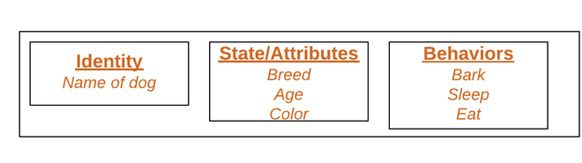

Slide 10
3. Data Abstraction:
Data abstraction refers to providing only essential information about the data to the outside world, hiding the background details or implementation.
Consider a real-life example of a man driving a car. The man only knows that pressing the accelerators will increase the speed of the car or applying brakes will stop the car, but he does not know about how on pressing the accelerator the speed is increasing, he does not know about the inner mechanism of the car or the implementation of the accelerator, brakes, etc in the car. This is what abstraction is.

Slide 11
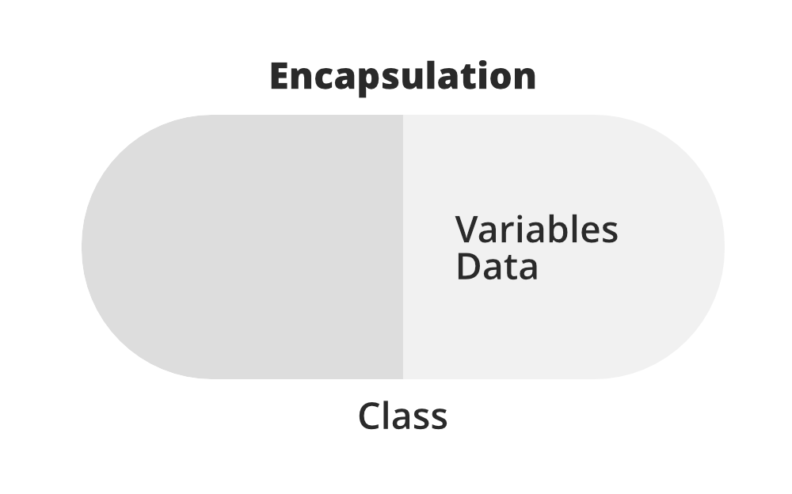
4. Encapsulation:
Encapsulation is defined as the wrapping up of data under a single unit.
It is the mechanism that binds together code and the data it manipulates.
In Encapsulation, the variables or data of a class are hidden from any other class and can be accessed only through any member function of their class in which they are declared
Also known as data-hiding.

Slide 12
5. Inheritance:
The capability of a class to derive (or bring) properties and characteristics from one class to another class is called Inheritance.
So, we do not need to write all the properties and functions again and again, as these can be inherited from another class that possesses it.
Inheritance allows the user to reuse the code whenever possible and reduce its redundancy.

Slide 13
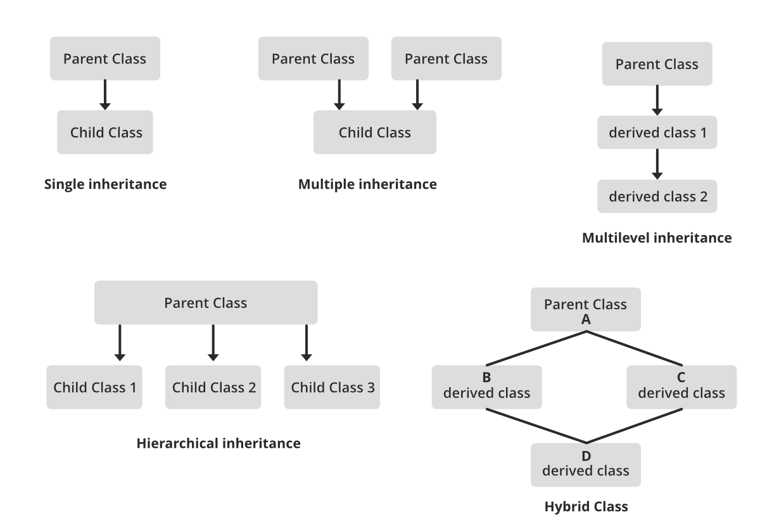

Slide 14
6. Polymorphism:
Polymorphism means having many forms.
For example, A person at the same time can have different characteristics.
Like a man at the same time is a father, a husband, an employee.
So the same person posses different behavior in different situations.

Slide 15
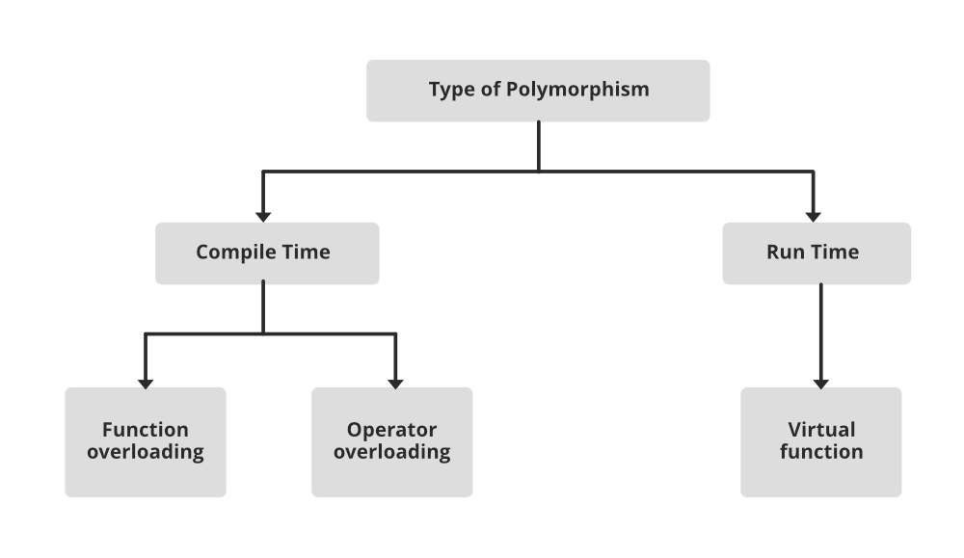

Slide 16
7. Dynamic Binding:
In dynamic binding, the code to be executed in response to the function call is decided at runtime.
Or the code associated with a given procedure call is not known until the time of the call at run time.
Dynamic Method Binding One of the main advantages of inheritance is that some derived class D has all the members of its base class B. Once D is not hiding any of the public members of B, then an object of D can represent B in any context where a B could be used. This feature is known as subtype polymorphism.

Slide 17
8. Message Passing:
It is a form of communication used in object-oriented programming as well as parallel programming.
Objects communicate with one another by sending and receiving information to each other.
A message for an object is a request for execution of a procedure and therefore will invoke a method in the receiving object that generates the desired results.
Message passing involves specifying the name of the object, the name of the method, and the information to be sent.

Slide 19
Identifiers
Rules of Identifiers

Slide 20
Reserved Words in Java
For Datatypes (8)
For control construct (11)
Keyword modifiers (11)
Exception Handling (6)
Class related (4)
Void
Unused keywords
Reserved literals
Enum

Slide 21
Datatypes in Java
Integral datatypes
Byes
Short
Int
Long
Floating Point Datatypes
Boolean datatype
Char datatype
String literals

Slide 22
Intro to Array
Array Declaration
Single Dimensional Array
Two Dimensional Array
Three Dimensional Array
Array Construction
Multi Dimensional Array Creation
Array Initialization
Array Declaration, Construction, Initialization, in a single line.
Length vs length() method
Anonymous array
Array element assignments
Array variable assignments

Slide 23
Types of variables
Primitive variables
Reference variables
Instance variables
Static variables
Local variables
Un-initialized arrays
Instance level
Static level
Local level
Var-Arg Method
Single Dimensional Array vs Var-Arg Method

Slide 24
main() method

Slide 25
Java Coding Standards
For classes
For interfaces
For methods
For variables
For constants
Java Bean Coding Standards
Setter methods
Getter methods
Coding Standards for listener
to register a listener
To unregister a listener

Slide 26
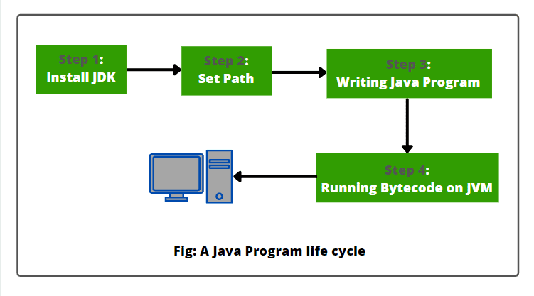

Slide 27
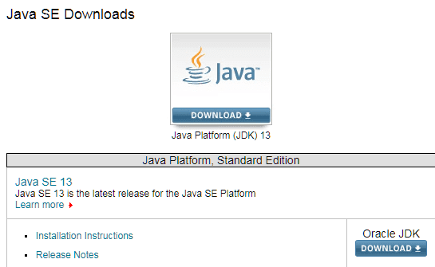
Installing JDK
https://www.oracle.com/technetwork/java/javase/downloads/index.html

Slide 28
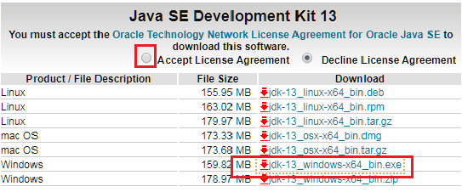
2. Accept License Agreement and download the latest Java JDK for your version (64 bit) of java for Windows.

Slide 29
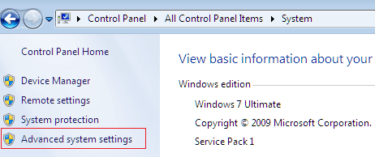
Set Path and Classpath in Environment Variables for Java?

Slide 30
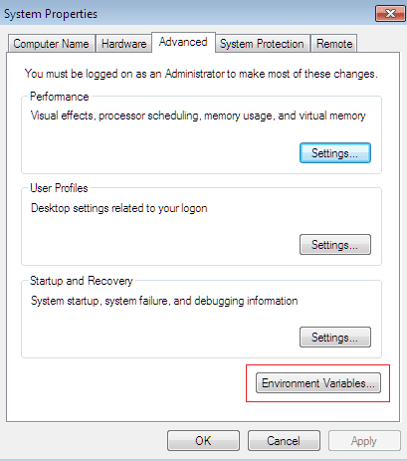

Slide 31
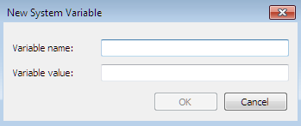

Slide 32
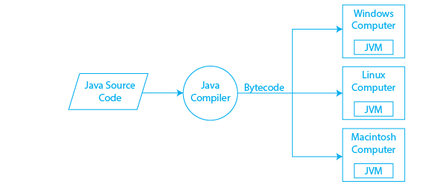
Java Compilation Process

Slide 33
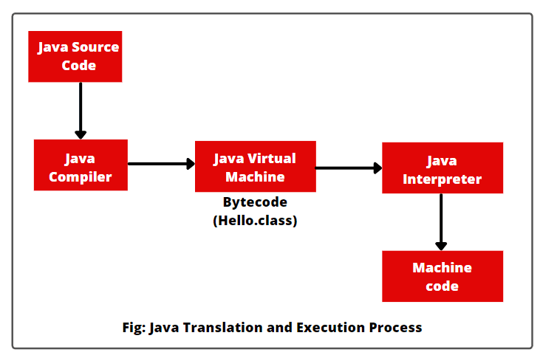

Slide 34
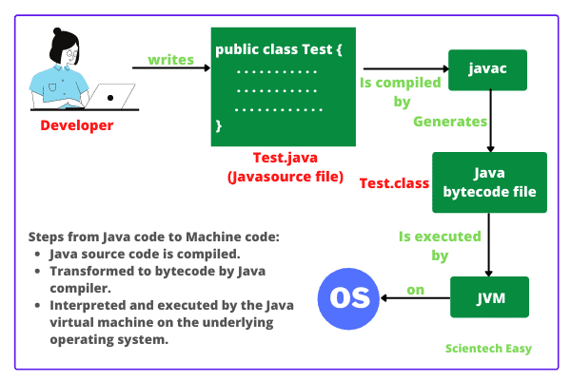

Slide 35
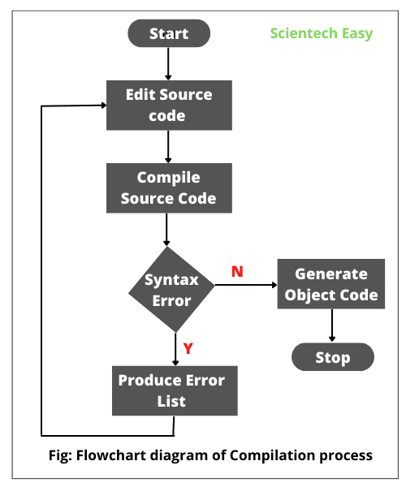

Slide 36
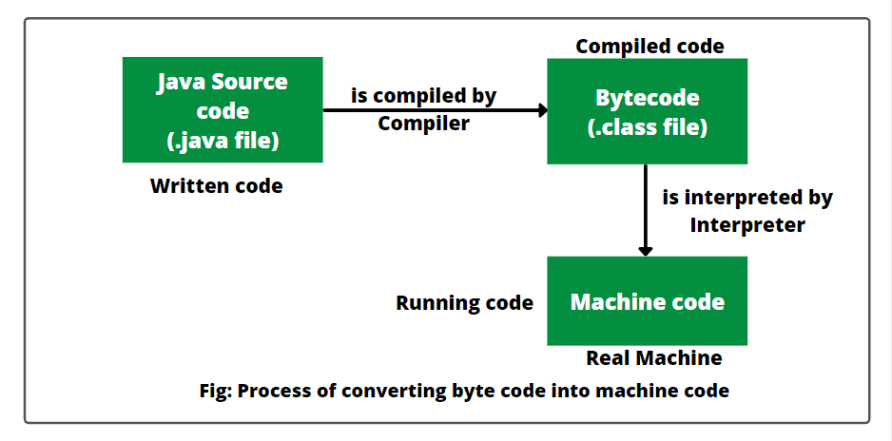

Slide 37

Java in Eclipse
https://www.eclipse.org/downloads

Slide 38


Slide 39


Slide 40
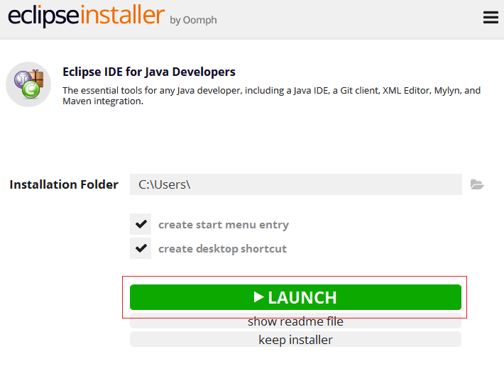

Slide 41
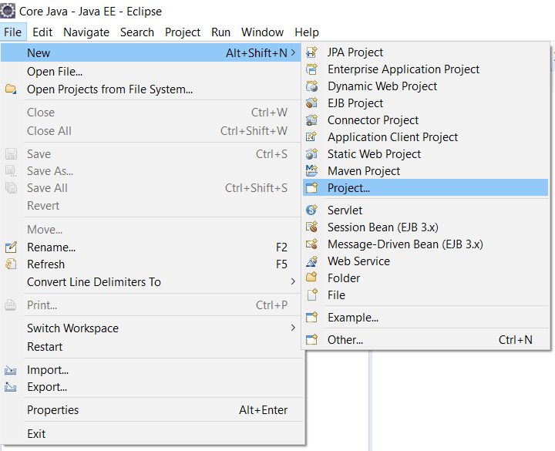

Slide 42
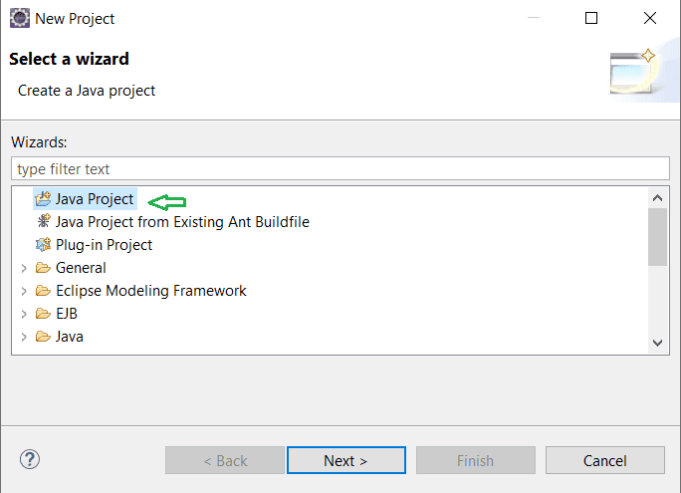

Slide 43
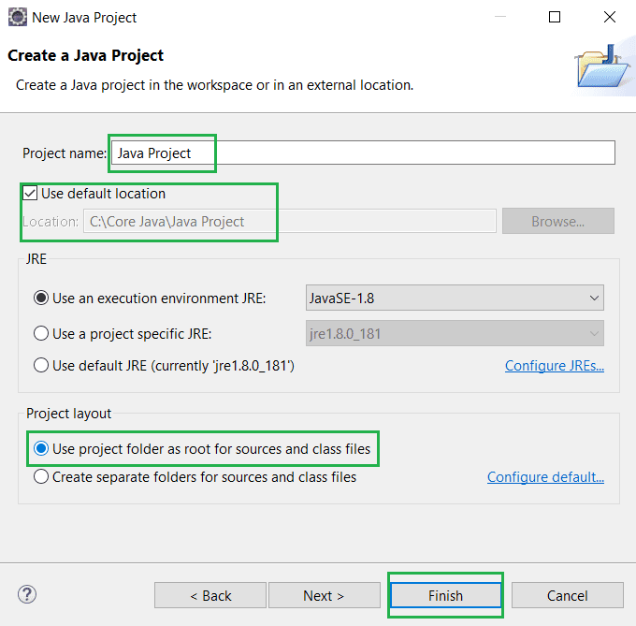

Slide 44
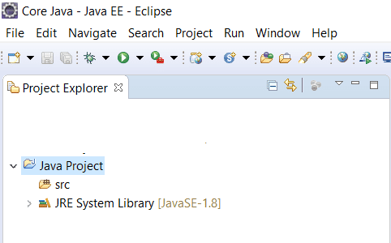

Slide 45
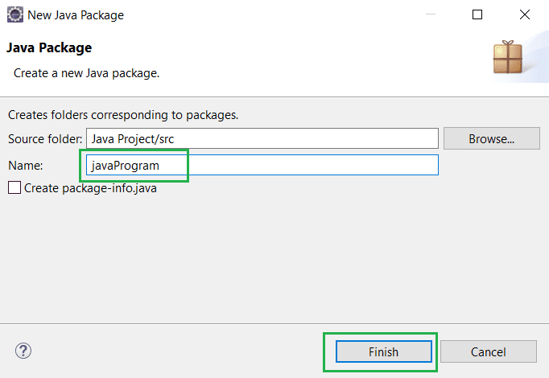

Slide 46
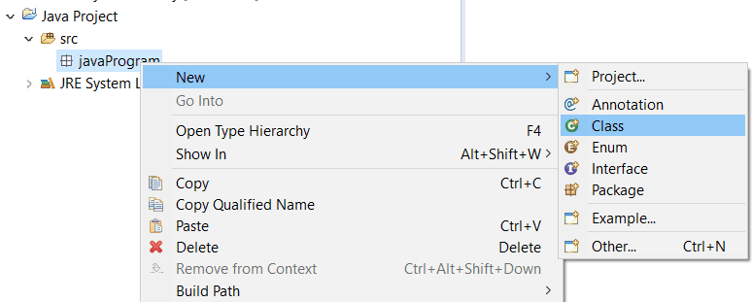

Slide 47
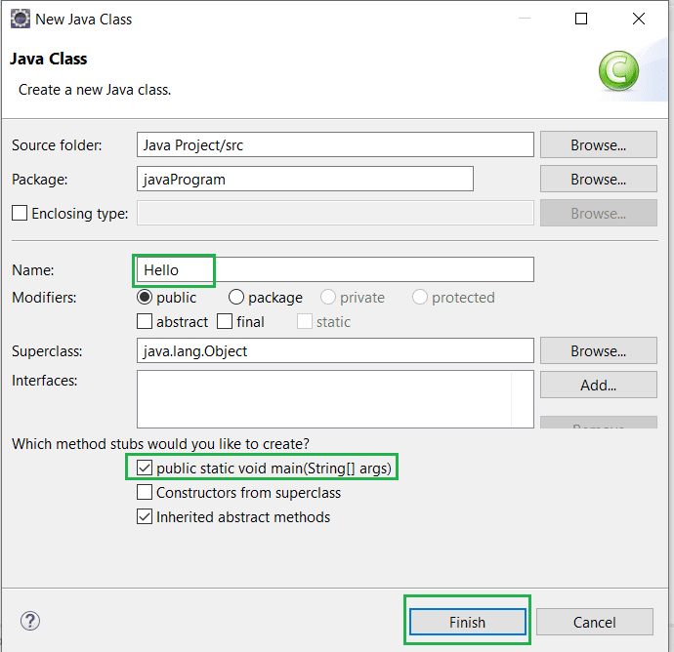

Slide 48
Identifiers
A name in java program is called identifier. It may be class name, method name, variable name and label name.
Rules to define java identifiers:
The only allowed characters in java identifiers are:
a to z 2)
A to Z 3)
0 to 9 4)
_ (underscore)
$

Slide 49
Identifiers
If we are using any other character we will get compile time error.
total_number
Total#
identifiers are not allowed to starts with digit.
ABC123
123ABC
java identifiers are case sensitive up course java language itself treated as case sensitive language.
class Test{
int number=10;
int Number=20;
int NUMBER=20; we can differentiate with case.
int NuMbEr=30;
}
There is no length limit for java identifiers but it is not recommended to take more than 15 lengths.
We can't use reserved words as identifiers.
int if=10;

Slide 50
All predefined java class names and interface names we use as identifiers.
class Test {
public static void main(String[] args){
int String=10;
System.out.println(String);
}}
Output: 10
class Test {
public static void main(String[] args){
int Runnable=10;
System.out.println(Runnable);
}} Output: 10
Even though it is legal to use class names and interface names as identifiers but it is not a good programming practice.

Slide 51
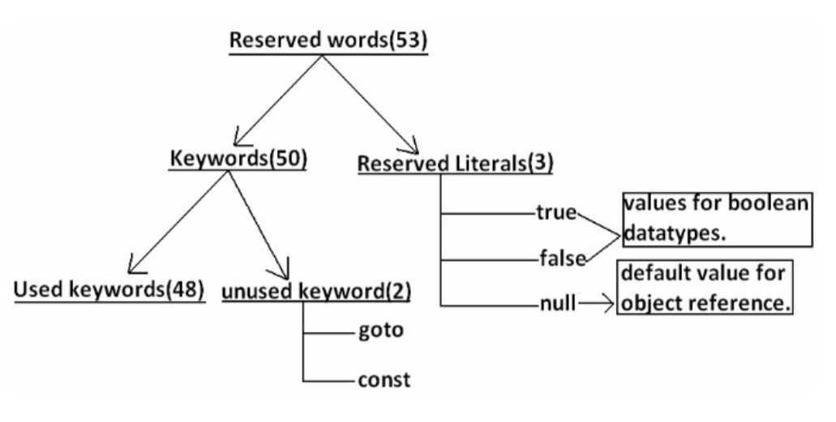
Reserved Words
In java some identifiers are reserved to associate some functionality or meaning such type of reserved identifiers are called reserved words.

Slide 52
Reserved words for data types: (8)
1) byte
2) short
3) int
4) long
5) float
6) double
7) char
8) boolean
Reserved words for flow control:(11)
1) if
2) else
3) switch
4) case
5) default
6) for
7) do
8) while
9) break
10) continue
11) return
Class related keywords:(6)
1) class
2) package
3) import
4) extends
5) implements
6) interface
Object related keywords:(4)
1) new
2) instanceof
3) super
4) this
Keywords for modifiers:(11)
1) public
2) private
3) protected
4) static
5) final
6) abstract
7) synchronized
8) native
9) strictfp(1.2 version)
10) transient
11) volatile
Keywords for exception handling:(6)
1) try
2) catch
3) finally
4) throw
5) throws
6) assert(1.4 version)

Slide 53
Void return type keyword:
If a method won't return anything compulsory that method should be declared with the void return type in java but it is optional in C++.
1) void
Unused keywords:
goto: Create several problems in old languages and hence it is banned in java. Const: Use final instead of this. By mistake if we are using these keywords in our program we will get compile time error.

Slide 54
Reserved literals:
1) true (values for boolean data type.)
2) false
3) null (default value for object reference.)
Enum: This keyword introduced in 1.5v to define a group of named constants
Example:
enum Beer { KF, RC, KO, FO; }

Slide 55
enum Color {
RED,
GREEN,
BLUE;
}
public class Test {
// Driver method
public static void main(String[] args) {
Color c1 = Color.RED;
System.out.println(c1);
}
}

Slide 56
// enum declaration inside a class.
public class Test {
enum Color {
RED,
GREEN,
BLUE;
}
// Driver method
public static void main(String[] args) {
Color c1 = Color.RED;
System.out.println(c1);
}
}

Slide 57
Every variable has a type, every expression has a type and all types are strictly define more over every assignment should be checked by the compiler by the type compatibility hence java language is considered as strongly typed programming language.
Java is pure object oriented programming or not?
Java is not considered as pure object oriented programming language because several oops features
(like multiple inheritance, operator overloading) are not supported by java moreover we are depending on primitive data types which are non objects.

Slide 58
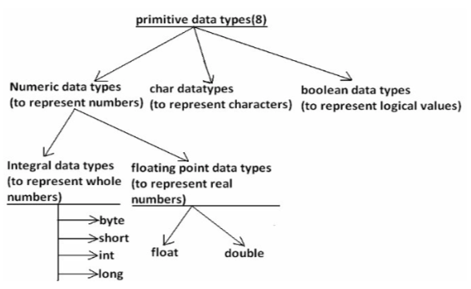

Slide 59
Except Boolean and char all remaining data types are considered as signed data types because we can represent both "+ve" and"-ve" numbers.
Integral data types :
Byte:
Size: 1byte (8bits)
Maxvalue: +127
Minvalue:-128
Range:-128to 127[-2⁷ to 2⁷-1]

Slide 60
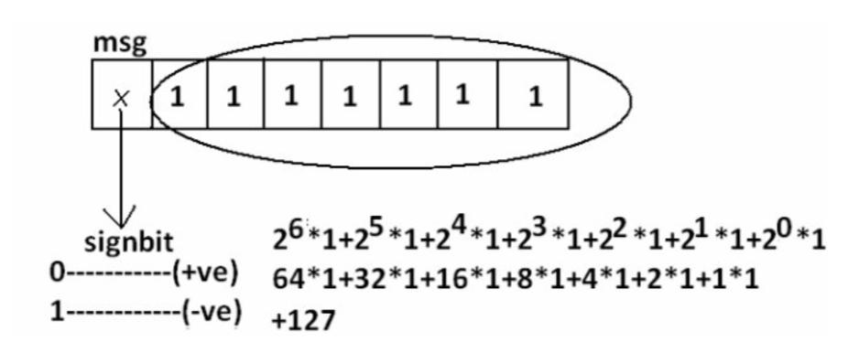
The most significant bit acts as sign bit.
"0" means "+ve" number and "1" means "–ve" number.
"+ve" numbers will be represented directly in the memory whereas "–ve" numbers will be represented in 2's complement form.

Slide 61
Example:
byte b=10;
byte b2=130;//C.E:possible loss of precision found : int required : byte byte
b=10.5;//C.E:possible loss of precision byte
b=true;//C.E:incompatible types byte
b="ashok";//C.E:incompatible types found : java.lang.String required : byte
byte data type is best suitable if we are handling data in terms of streams either from the file or from the network.

Slide 62
Short:
The most rarely used data type in java is short.
Size: 2 bytes
Range: -32768 to 32767(-2 15 to 2 15 -1)
Example:
short s=130;
short s=32768;//C.E:possible loss of precision
short s=true;//C.E:incompatible types
Short data type is best suitable for 16 bit processors like 8086 but these processors are completely outdated and hence the corresponding short data type is also out data type.

Slide 63
Int:
This is most commonly used data type in java.
Size: 4 bytes
Range:-2147483648 to 2147483647 (-2 31 to 2 31 -1)
Example:
int i=130;
int i=10.5;//C.E:possible loss of precision
int i=true;//C.E:incompatible types

Slide 64
long:
Whenever int is not enough to hold big values then we should go for long data type.
Example:
To hold the no. Of characters present in a big file int may not enough hence the return type of length() method is long.
long l=f.length();//f is a file
Size: 8 bytes
Range:-2⁶³ to 2⁶³-1
Note: All the above data types (byte, short, int and long) can be used to represent whole numbers. If we want to represent real numbers then we should go for floating point data types.

Slide 65
Floating Point Data types:
float
If we want to 5 to 6 decimal places of accuracy then we should go for float.
Size:4 bytes.
Range:-3.4e³⁸ to 3.4e³⁸.
float follows single precision.
double
If we want to 14 to 15 decimal places of accuracy then we should go for double.
Size:8 bytes.
-1.7e³⁰⁸ to1.7e³⁰⁸.
double follows double precision.

Slide 66
boolean data type:
Size: Not applicable (virtual machine dependent)
Range: Not applicable but allowed values are true or false.

Slide 67
Char data type:
In old languages like C & C++ are ASCII code based the no.Of ASCII code characters are < 256 to represent these 256 characters 8 - bits enough hence char size in old languages 1 byte.
In java we are allowed to use any worldwide alphabets character and java is Unicode based and no.Of unicode characters are > 256 and <= 65536 to represent all these characters one byte is not enough compulsory we should go for 2 bytes.
Size: 2 bytes
Range: 0 to 65535
Example: char ch1=97;
char ch2=65536;//C.E:possible loss of precision

Slide 68
data type | Size | Range | Corresponding Wrapper class | Default value
byte | 1 byte | -2⁷ to 2⁷ -1(-128 to 127) | Byte | 0
short | 2 bytes | -2¹⁵ to 2¹⁵ -1 (-32768 to 32767) | Short | 0
int | 4 bytes | -2³¹ to 2³¹ -1 (-2147483648 to 2147483647) | Integer | 0
long | 8 bytes | -2⁶³ to 2⁶³ -1 | Long | 0
float | 4 bytes | -3.4e³⁸ to 3.4e³⁸ | Float | 0.0
double | 8 bytes | -1.7e³⁰⁸ to 1.7e³⁰⁸ | Double | 0.0
boolean | Not applicable | Not applicable(but allowed values true|false) | Boolean | false
char | 2 bytes | 0 to 65535 | Character | 0 (represent blank space)

Slide 69
Any constant value which can be assigned to the variable is called literal.
Integral Literals:
For the integral data types (byte, short, int and long) we can specify literal value in the following ways.
1) Decimal literals: Allowed digits are 0 to 9.
Example: int x=10;
2) Octal literals: Allowed digits are 0 to 7.
Literal value should be prefixed with zero.
Example: int x=010;
3) Hexa Decimal literals: The allowed digits are 0 to 9, A to F.
For the extra digits we can use both upper case and lower case characters.
This is one of very few areas where java is not case sensitive.
Literal value should be prefixed with ox(or)oX.
Example: int x=0x10;

Slide 70
int d = 10;
int o = 010;
int x = 0x10;
int b = 0b101;
System.out.println("d: "+d);
System.out.println("o: "+o);
System.out.println("x: "+x);
System.out.println("b: "+b);

Slide 71
By default every integral literal is int type but we can specify explicitly as long type by
suffixing with small "l" (or) capital "L".
Example:
int x=10;(valid)
long l=10L;(valid)
long l=10;(valid)
int x=10l;//C.E:possible loss of precision(invalid)
found : long
required : int

Slide 72
There is no direct way to specify byte and short literals explicitly.
But whenever we are assigning integral literal to the byte variables and its value within the range of byte compiler automatically treats as byte literal.
Similarly short literal also.
Example:
byte b=127;(valid)
byte b=130;//C.E:possible loss of precision(invalid)
short s=32767;(valid)
short s=32768;//C.E:possible loss of precision(invalid)

Slide 73
Floating Point Literals:
Floating point literal is by default double type but we can specify explicitly as float type by suffixing with f or F.
Example:
float f=123.456; //C.E:possible loss of precision(invalid)
float f=123.456f; (valid)
double d=123.456; (valid)
We can specify explicitly floating point literal as double type by suffixing with d or D.
Example:
double d=123.456D;
We can specify floating point literal only in decimal form and we can't specify in octal and hexadecimal forms.
Example:
double d=123.456; (valid)
double d=0123.456; (valid) //it is treated as decimal value but not octal
double d=0x123.456; //C.E:malformed floating point literal(invalid)

Slide 74
We can assign integral literal directly to the floating point data types and that integral literal can be specified in decimal , octal and Hexa decimal form also.
Example:
double d=0xBeef;
System.out.println(d); //48879.0
But we can't assign floating point literal directly to the integral types.
Example:
int x=10.0; //C.E:possible loss of precision
We can specify floating point literal even in exponential form also(significant notation).
Example:
double d=10e2;//==>10*10² (valid)
System.out.println(d); //1000.0
float f=10e2; //C.E:possible loss of precision(invalid)
float f=10e2F; (valid)

Slide 75
Boolean literals:
The only allowed values for the boolean type are true (or) false where case is important. i.e., lower case
Example:
1. boolean b=true; (valid)
2. boolean b=0; //C.E:incompatible types(invalid)
3. boolean b=True; //C.E:cannot find symbol(invalid)
4. boolean b="true"; //C.E:incompatible types(invalid)

Slide 76
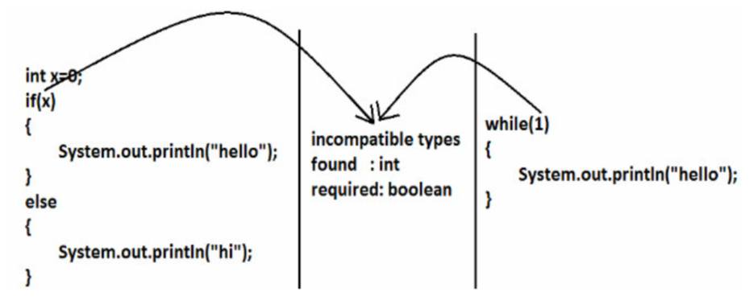
Literals:

Slide 77
Char literals:
1) A char literal can be represented as single character within single quotes.
Example:
1. char ch='a';(valid)
2. char ch=a;//C.E:cannot find symbol(invalid)
3. char ch="a";//C.E:incompatible types(invalid)
4. char ch='ab';//C.E:unclosed character literal(invalid)
2) We can specify a char literal as integral literal which represents Unicode of that character.
We can specify that integral literal either in decimal or octal or hexadecimal form but allowed values range is 0 to 65535.
Example:
1. char ch=97; (valid)
2. char ch=0xFace; (valid)
System.out.println(ch); //?
3. char ch=65536; //C.E: possible loss of precision(invalid)

Slide 78
3) We can represent a char literal by Unicode representation which is nothing but
‘\uxxxx' (4 digit hexa-decimal number) .
Example:
1. char ch='\ubeef';
2. char ch1='\u0061';
System.out.println(ch1); //a
3. char ch2=\u0062; //C.E:cannot find symbol
4. char ch3='\iface'; //C.E:illegal escape character
5. Every escape character in java acts as a char literal.
Example:
1) char ch='\n'; //(valid)
2) char ch='\l'; //C.E:illegal escape character(invalid)

Slide 79
String literals:
Any sequence of characters with in double quotes is treated as String literal.
Example:
String s="Ashok"; (valid)
1.7 Version enhansements with respect to Literals :
The following 2 are enhansements
1. Binary Literals
2. Usage of '_' in Numeric Literals

Slide 80
Binary Literals :
For the integral data types untill 1.6v we can specify literal value in the following ways
1. Decimal
2. Octal
3. Hexa decimal
But from 1.7v onwards we can specified literal value in binary form also.
The allowed digits are 0 to 1.
Literal value should be prefixed with Ob or OB .
int x = 0b111;
System.out.println(x); // 7

Slide 81
Usage of _ symbol in numeric literals :
From 1.7v onwards we can use underscore(_) symbol in numeric literals.
double d = 123456.789; //valid
double d = 1_23_456.7_8_9; //valid
double d = 123_456.7_8_9; //valid
The main advantage of this approach is readability of the code improved at the time of compilation ' _ ' symbols will be removed automatically , hence after compilation the above lines will become double d = 123456.789
We can use more than one underscore symbol also between the digits.
Ex : double d = 1_23_ _456.789;
We should use underscore symbol only between the digits
double d=_1_23_456.7_8_9; //invalid
double d=1_23_456.7_8_9_; //invalid
double d=1_23_456_.7_8_9; //invalid
double d='a';
System.out.println(d); //97
integral data types
float f=10L;
System.out.println(f); //10.0
floating-point data types

Slide 82
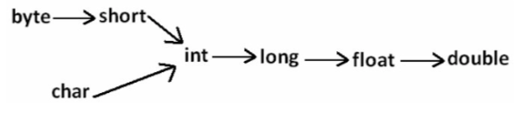
Numerical Data Migrates

Slide 83
Naming conventions
Naming conventions make code easier to read for programmers himself/herself and for other programmers.
Readability means less time is spent trying to figure out what the code does, leaving more time to fix or modify it.
When choosing a name for an identifier, make sure it's meaningful.
For example, if your program deals with customer accounts then choose names that make sense for dealing with customers and their accounts (e.g., customerName, accountDetails).
Don't worry about the length of the name. A longer name that sums up the identifier perfectly is preferable to a shorter name that might be quick to type but ambiguous.

Slide 84
Packages: Names should be in lowercase.
names: package pokeranalyzer package mycalculator
In software companies and large projects where the packages might be imported into other classes, the names will normally be subdivided. Typically this will start with the company domain before being split into layers or features:
package com.mycompany.utilities
package org.bobscompany.application.userinterface
Classes: Names should be in CamelCase. Try to use nouns because a class is normally representing something in the real world:
class Customer class Account
Interfaces: Names should be in CamelCase. They tend to have a name that describes an operation that a class can do:
interface Comparable interface Enumerable
Note that some programmers like to distinguish interfaces by beginning the name with an "I": interface IComparable interface IEnumerable

Slide 85
Methods: Names should be in mixed case. Use verbs to describe what the method does:
void calculateTax() string getSurname()
Variables: Names should be in mixed case. The names should represent what the value of the variable represents:
string firstName int orderNumber
Only use very short names when the variables are short-lived, such as in for loops:
for (int i=0; i<20;i++) {
//i only lives in here
}
Constants: Names should be in uppercase.
static final int DEFAULT_WIDTH static final int MAX_HEIGHT

Slide 86
Drawing class Diagram

Slide 87
Static variables and static methods and static block
The static keyword in Java is used for memory management mainly. We can apply static keyword with variables, methods, blocks and nested classes. The static keyword belongs to the class than an instance of the class.
Variable (also known as a class variable)
Method (also known as a class method)
Block
Nested class

Slide 88
Develop code for finding the factorial of a number.

Slide 89
class Calculator{
public static int sum(int a, int b){
return a+b;
}
public static void main(String args[]){
int ans = sum(10, 20);
System.out.println("Sum: "+ ans);
}
}

Slide 90
UML Diagram-For Class Designing
The UML Class diagram is a graphical notation used to construct and visualize object oriented systems.
A class diagram in the Unified Modeling Language (UML) is a type of static structure diagram that describes the structure of a system:
classes,
their attributes,
operations (or methods),
and the relationships among objects.

Slide 91
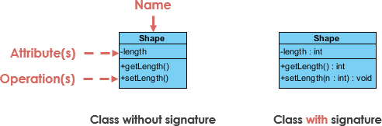
UML Class Notation
A class represent a concept which encapsulates state (attributes) and behavior (operations).
Each attribute has a type.
Each operation has a signature.
The class name is the only mandatory information.

Slide 92
Class Name:
The name of the class appears in the first partition.
Class Attributes:
Attributes are shown in the second partition.
The attribute type is shown after the colon.
Attributes map onto member variables (data members) in code.
Class Operations (Methods):
Operations are shown in the third partition. They are services the class provides.
The return type of a method is shown after the colon at the end of the method signature.
The return type of method parameters are shown after the colon following the parameter name. Operations map onto class methods in code

Slide 93
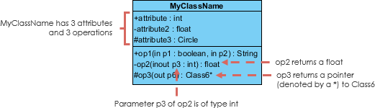

Slide 94
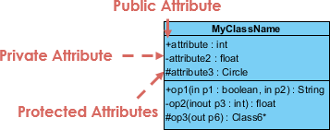
Class Visibility
The +, - and # symbols before an attribute and operation name in a class denote the visibility of the attribute and operation.
+ denotes public attributes or operations
- denotes private attributes or operations
# denotes protected attributes or operations

Slide 95
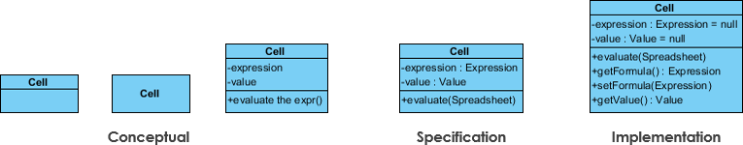
Perspectives of Class Diagram
A diagram can be interpreted from various perspectives:
Conceptual: represents the concepts in the domain
Specification: focus is on the interfaces of Abstract Data Type (ADTs) in the software
Implementation: describes how classes will implement their interfaces
The perspective affects the amount of detail to be supplied and the kinds of relationships worth presenting. As we mentioned above, the class name is the only mandatory information.

Slide 96
Relationships between classes
UML precisely conveys how code should be implemented from diagrams.
If precisely interpreted, the implemented code will correctly reflect the intent of the designer.
A class may be involved in one or more relationships with other classes.
A relationship can be one of the following types:

Slide 97
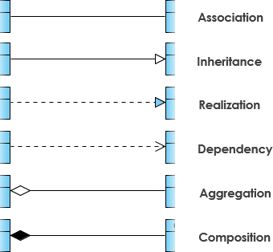

Slide 98
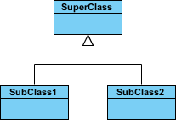
Inheritance (or Generalization):
A generalization is a taxonomic relationship between a more general classifier and a more specific classifier.
Each instance of the specific classifier is also an indirect instance of the general classifier. Thus, the specific classifier inherits the features of the more general classifier.
Represents an "is-a" relationship.
An abstract class name is shown in italics.
SubClass1 and SubClass2 are specializations of SuperClass.

Slide 99
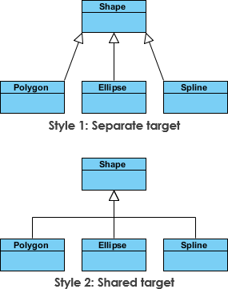

Slide 100

Association
Associations are relationships between classes in a UML Class Diagram.
They are represented by a solid line between classes.
Associations are typically named using a verb or verb phrase which reflects the real world problem domain.

Slide 101
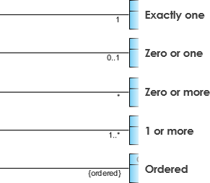

Slide 102

Aggregation
A special type of association.
It represents a "part of" relationship.
Class2 is part of Class1.
Many instances (denoted by the *) of Class2 can be associated with Class1.
Objects of Class1 and Class2 have separate lifetimes.

Slide 103

Composition
A special type of aggregation where parts are destroyed when the whole is destroyed.
Objects of Class2 live and die with Class1.
Class2 cannot stand by itself.
The relationship is displayed as a solid line with a filled diamond at the association end, which is connected to the class that represents the whole or composite.

Slide 104

Dependency
An object of one class might use an object of another class in the code of a method. If the object is not stored in any field, then this is modeled as a dependency relationship.
A special type of association.
Exists between two classes if changes to the definition of one may cause changes to the other (but not the other way around).
Class1 depends on Class2
The relationship is displayed as a dashed line with an open arrow.

Slide 105

The figure below shows another example of dependency. The Person class might have a hasRead method with a Book parameter that returns true if the person has read the book (perhaps by checking some database).

Slide 106
Realization
Realization is a relationship between the blueprint class and the object containing its respective implementation level details.
This object is said to realize the blueprint class. In other words, you can understand this as the relationship between the interface and the implementing class.

Slide 107
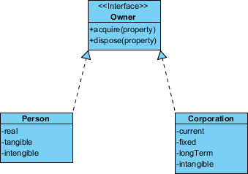
For example, the Owner interface might specify methods for acquiring property and disposing of property. The Person and Corporation classes need to implement these methods, possibly in very different ways.

Slide 108
Class Diagram Example: Order System

Slide 109
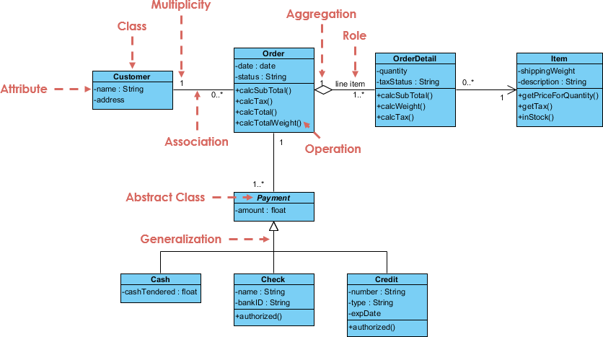

Slide 110
Types of Variable
Based the type of value represented by the variable all variables are divided into 2 types. 1) Primitive variables 2) Reference variables
Primitive variables: Primitive variables can be used to represent primitive values.
Example: int x=10;
Reference variables: Reference variables can be used to refer objects.
Example: Student s=new Student();

Slide 111
Based on the purpose and position of declaration all variables are divided into the following 3 types. 1) Instance variables 2) Static variables 3) Local variables

Slide 112
Instance Variable
If the value of a variable is varied from object to object such type of variables are called instance variables.
For every object a separate copy of instance variables will be created.
Instance variables will be created at the time of object creation and destroyed at the time of object destruction hence the scope of instance variables is exactly same as scope of objects.
Instance variables will be stored on the heap as the part of object.
Instance variables should be declared with in the class directly but outside of any method or block or constructor.
Instance variables can be accessed directly from Instance area. But cannot be accessed directly from static area.
But by using object reference we can access instance variables from static area

Slide 113
class Test
{
int i=10;
public static void main(String[] args)
{
//System.out.println(i);//C.E:non-static variable i cannot be referenced from a
static context(invalid)
Test t=new Test();
System.out.println(t.i);//10(valid)
t.methodOne();
}
public void methodOne()
{
System.out.println(i);//10(valid)
}
}
For the instance variables it is not required to perform initialization JVM will always provide default values.

Slide 114
class Test
{
boolean b;
public static void main(String[] args)
{
Test t=new Test();
System.out.println(t.b);//false
}
}
Instance variables also known as object level variables or attributes.

Slide 115
Static variables:
If the value of a variable is not varied from object to object such type of variables is not recommended to declare as instance variables. We have to declare such type of variables at class level by using static modifier.
In the case of instance variables for every object a separate copy will be created but in the case of static variables for entire class only one copy will be created and shared by every object of that class.
Static variables will be crated at the time of class loading and destroyed at the time of class unloading hence the scope of the static variable is exactly same as the scope of the .class file.
Static variables will be stored in method area. Static variables should be declared with in the class directly but outside of any method or block or constructor.
Static variables can be accessed from both instance and static areas directly.
We can access static variables either by class name or by object reference but usage of class name is recommended.
But within the same class it is not required to use class name we can access directly.

Slide 116
1) Start JVM. 2) Create and start Main Thread by JVM. 3) Locate(find) Test.class by main Thread. 4) Load Test.class by main Thread. 5) Execution of main() method. 6) Unload Test.class 7) Terminate main Thread. 8) Shutdown JVM.

Slide 117
class Test
{
static int i=10;
public static void main(String[] args)
{
Test t=new Test();
System.out.println(t.i);//10
System.out.println(Test.i);//10
System.out.println(i);//10
}
}
For the static variables it is not required to perform initialization explicitly, JVM will always provide default values.

Slide 118
class Test
{
int x=10;
static int y=20;
public static void main(String[] args)
{
Test t1=new Test();
t1.x=888;
t1.y=999;
Test t2=new Test();
System.out.println(t2.x+"----"+t2.y);//10----999
}
}
Static variables also known as class level variables or fields.
class Test
{
static String s;
public static void main(String[] args)
{
System.out.println(s);//null
}
}

Slide 119
Local Variables
Some time to meet temporary requirements of the programmer we can declare variables inside a method or block or constructors such type of variables are called local variables or automatic variables or temporary variables or stack variables.
The local variables will be created as part of the block execution in which it is declared and destroyed once that block execution completes. Hence the scope of the local variables is exactly same as scope of the block in which we declared.

Slide 120
class Test
{
public static void main(String[] args)
{
int i=0;
for(int j=0;j<3;j++)
{
i=i+j;
}
}
}
class Test
{
public static void main(String[] args)
{
try
{
int i=Integer.parseInt("ten");
}
catch(NullPointerException e)
{
}
}
}
The local variables will be stored on the stack.
For the local variables JVM won’t provide any default values compulsory we should perform initialization explicitly before using that variable.

Slide 121
class Test
{
public static void main(String[] args)
{
int x;
if(args.length>0)
{
x=10;
}
System.out.println(x);//C.E:variable x might not have been initialized
}
}
class Test
{
public static void main(String[] args)
{
int x;
if(args.length>0)
{
x=10;
}
else
{
x=20;
}
System.out.println(x);
}
}

Slide 122
It is never recommended to perform initialization for the local variables inside logical blocks because there is no guarantee of executing that block always at runtime.
It is highly recommended to perform initialization for the local variables at the time of declaration at least with default values.
Note: The only applicable modifier for local variables is final. If we are using any other modifier we will get compile time error

Slide 123
class Test
{
public static void main(String[] args)
{
public int x=10;
private int x=10;
protected int x=10; //C.E: illegal start of expression
static int x=10;
volatile int x=10;
transient int x=10;
final int x=10;//(valid)
}
}

